Slide 1
Face Recognition
Under
Dr. Obulapathi Naidu Challa
CEO-Moonshots Company
PhD , University of Florida, USA
-By
Gopi Durgaprasad
N150762

Slide 2
Contents
Introduction
End to End Modle
Challenges
FaceNet
Retina Face
Model Overview
Data Collection & Preprocessing
Training Data
Exploration Data Analysis
Modeling, Evaluation & Interpretation
Results

Slide 3
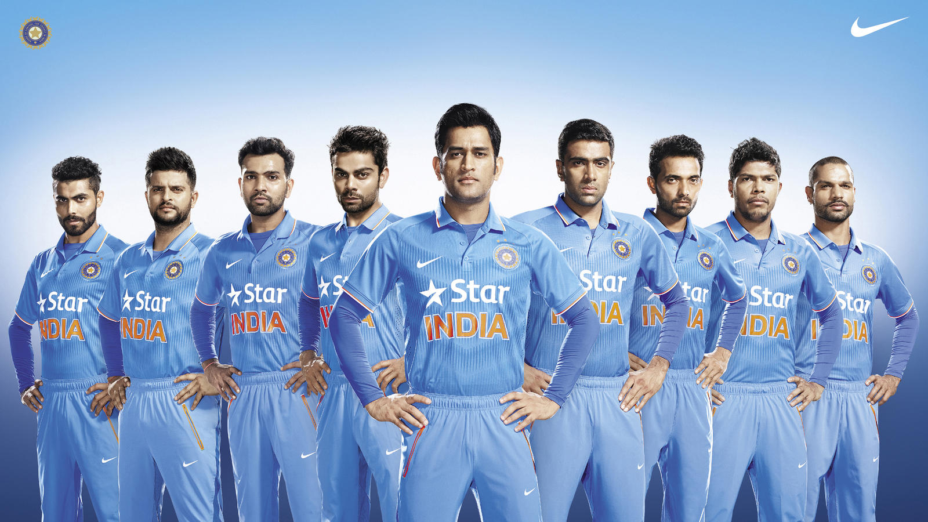
Introduction
Can you recognise people in this image

Slide 4
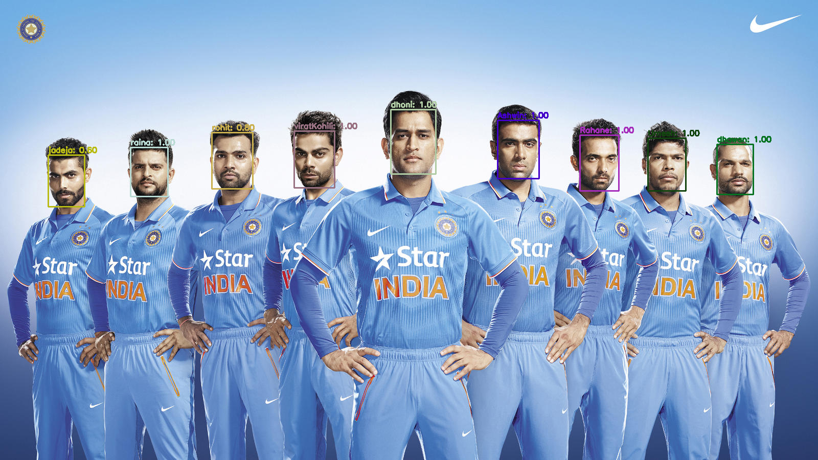
Introduction
Recognised by computer very fast, with in 1-2 Sec.

Slide 5
History
In 1960s, the first semi-automated system for facial recognition to locate the features(such as eyes, ears, nose and mouth) on the photographs.
In 1970s, Goldstein and Harmon used 21 specific subjective markers such as hair color and lip thickness to automate the recognition.
In 1988, Kirby and Sirovich used standard linear algebra technique, to the face recognition.

Slide 6
End-To-End Models
Image
Black Box
Recognise
Problems:
If you want to add new face to model, then you can train total entire model.
It takes lot of time to train a model
It’s very time consuming problem

Slide 7
Challenges
Face Recognition there are mainly three challenges.
Detecting Faces
Get Embeddings for faces
Train model Clustering/Classification/Similarity matrix to recognize the face

Slide 8
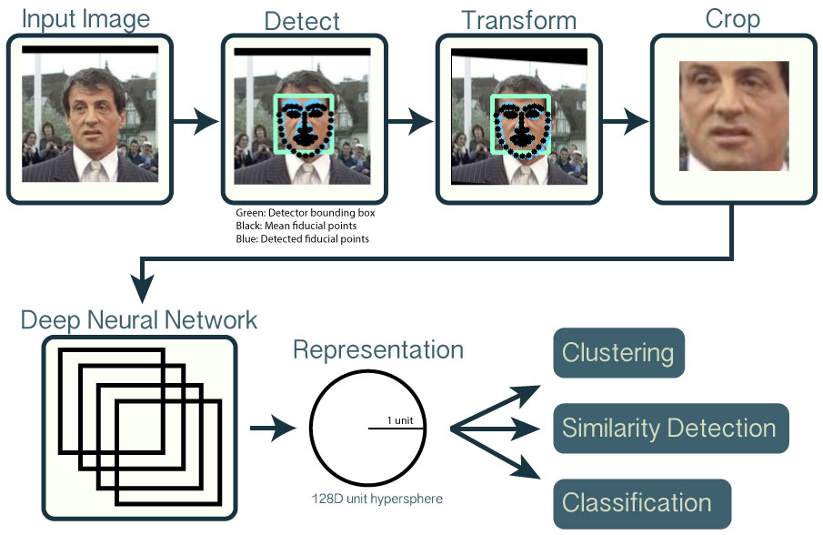
Model Formation

Slide 9
Detecting Face
The first main challenge is Detecting Faces from a given image, there are many models to detect faces in an image
We are using RetinaFace
RetinaFace: Single-stage Dense Face Localisation in the Wild
The proposed single-stage pixel-wise face localisation method employs extra-supervised and self-supervised multi-task learning in parallel with the existing box classification and regression branches. Each positive anchor outputs (1) a face score,
(2) a face box,
(3) five facial landmarks,
(4) dense 3D face vertices projected on the image plane

Slide 10
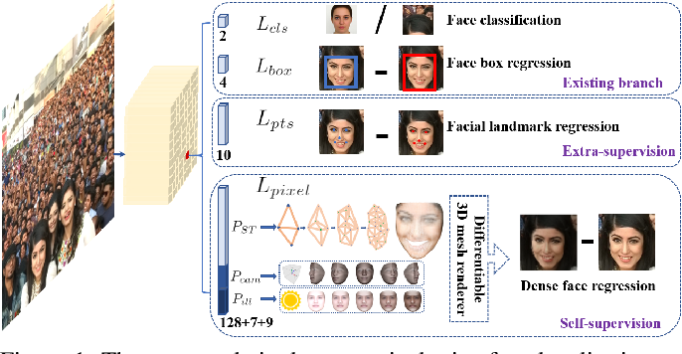
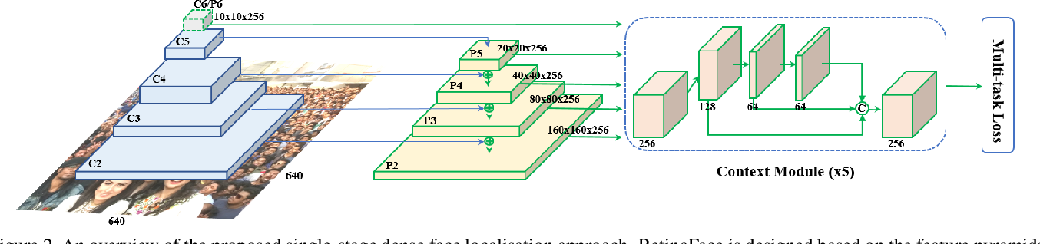
RetinaFace

Slide 11
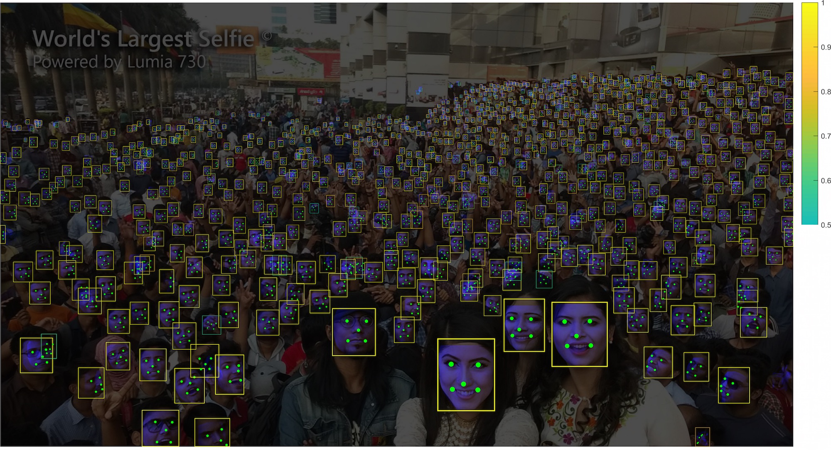
RetinaFace

Slide 12
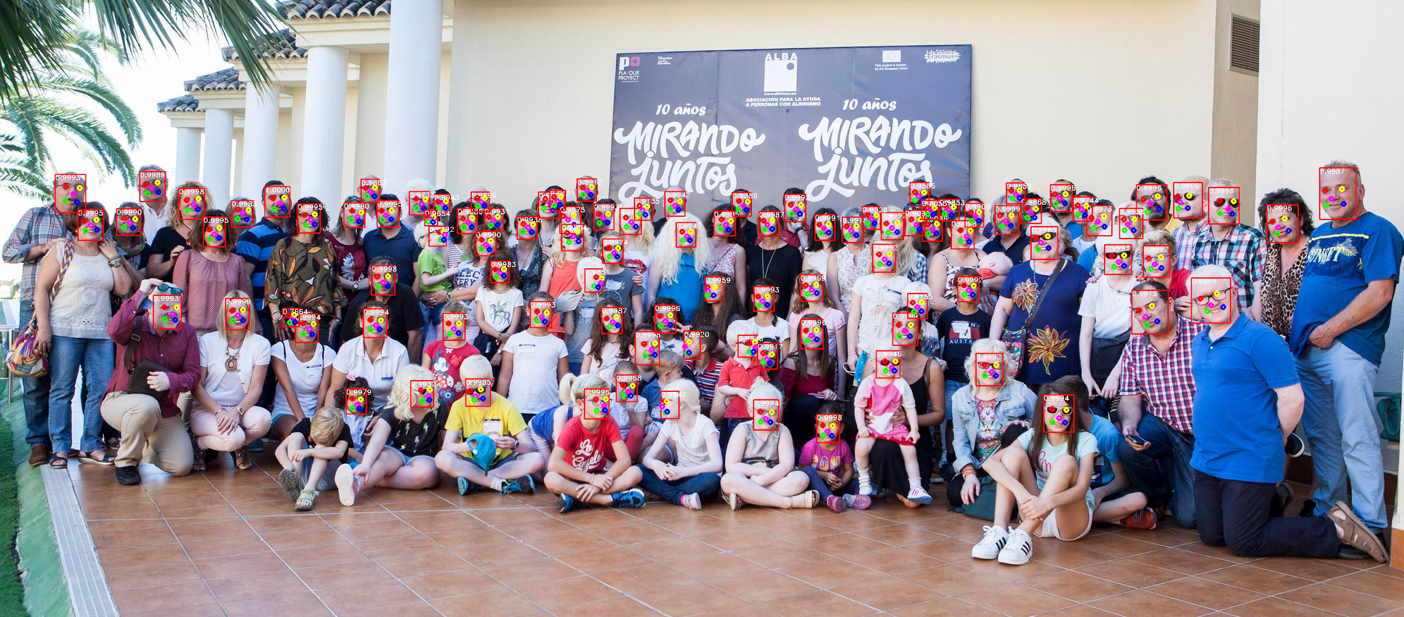
RetinaFace

Slide 13
Get Embeddings for faces
The second challenge is getting embedding for the detected faces, we are using FaceNet Model for getting Embeddings for faces.
FaceNet: A Unified Embedding for Face Recognition and Clustering
FaceNet directly learns a mapping from face images to a compact Euclidean space where distances directly correspond to a measure of face similarity. Once this space has been produced, tasks such as face recognition, verification and clustering can be easily implemented using standard techniques with FaceNet embeddings as feature vectors.

Slide 14
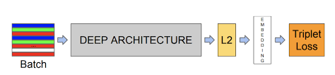
FaceNet
FaceNet: A Unified Embedding for Face Recognition and Clustering
Model structure : Our network consists of a batch input layer and a deep CNN followed by L2 normalization, which results in the face embedding. This is followed by the triplet loss during training.

Slide 15
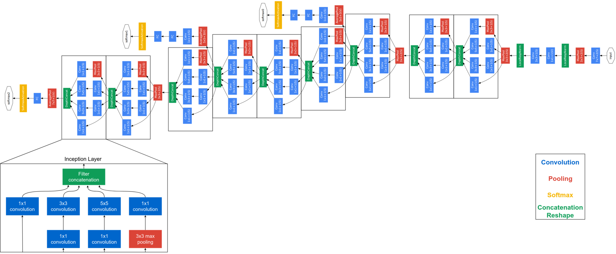
FaceNet Deep Architecture
The authors tried out 4 different CNN architectures and at the end Inception v1 produced the best results

Slide 16
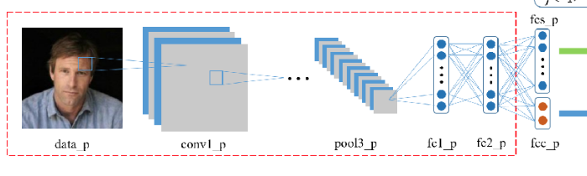
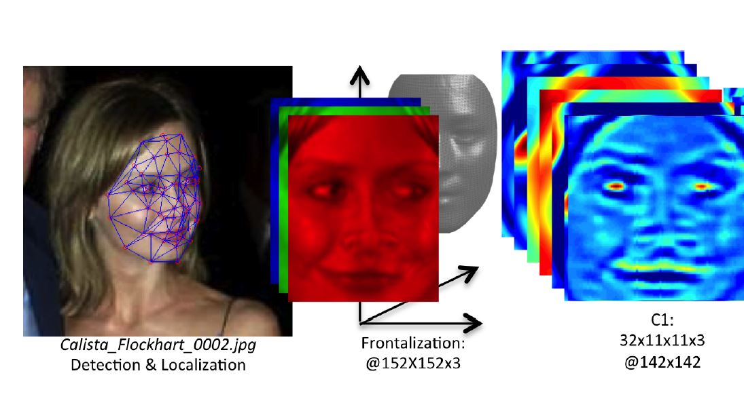

Slide 17
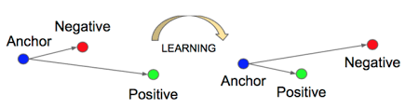
FaceNet
FaceNet: A Unified Embedding for Face Recognition and Clustering
The Triplet Loss minimizes the distance between an anchor and a positive, both of which have the same identity, and maximizes the distance between the anchor and a negative of a different identity.

Slide 18
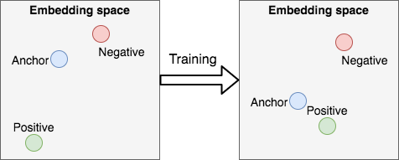
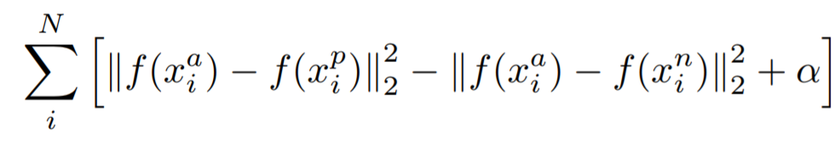
FaceNet Triplet-loss

Slide 19
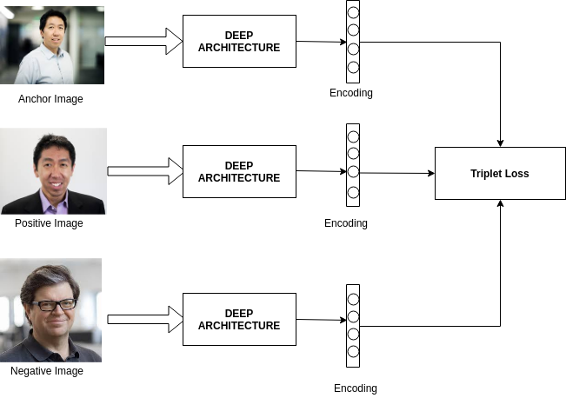
FaceNet

Slide 20
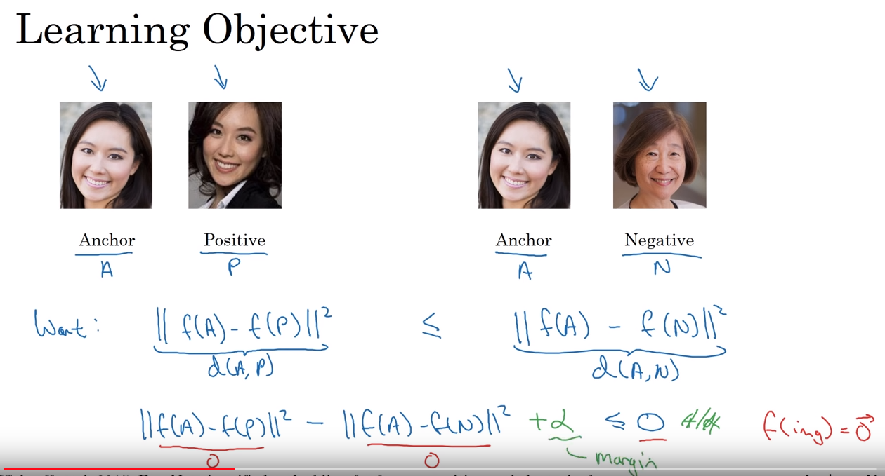

Slide 21

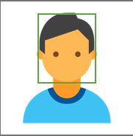


Model Overview
RetinaFace
Face Image
Detect Face
Crop Face
Resize - 160x160
FaceNet
ML Model
Identify face
Resize - 160x160
512 -D

Slide 22
ML Models
There are three main ways to train a model to recognize the face
Using Clustering
K-Means
Hierarchical
Using Classification
SVM
KNN
Using Similarity Matrix
L2 norm
L1 norm
Cosine Similarity

Slide 23
Training data
Dataset : CASIA-WebFace
This training set consists of total of ~3.3M faces and ~9000 classes.
We trained on 2 GPUs
It’s take 2 days to train

Slide 24
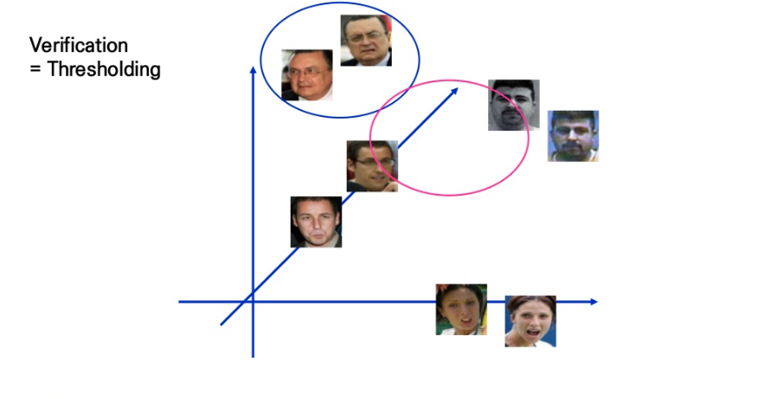

Slide 25
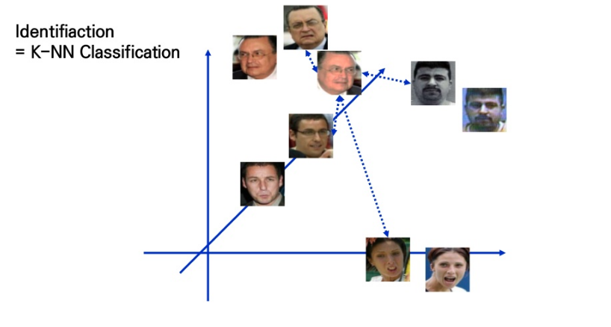

Slide 26
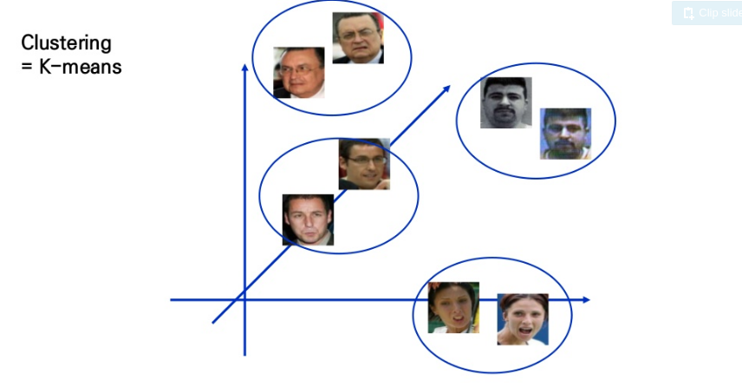

Slide 27
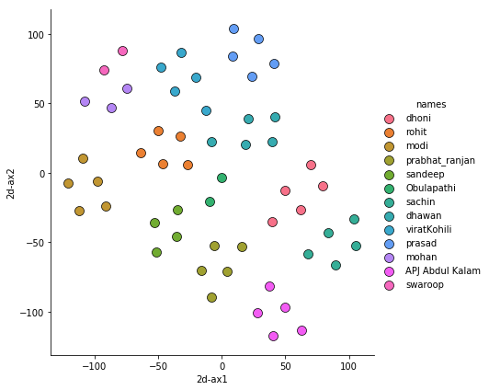
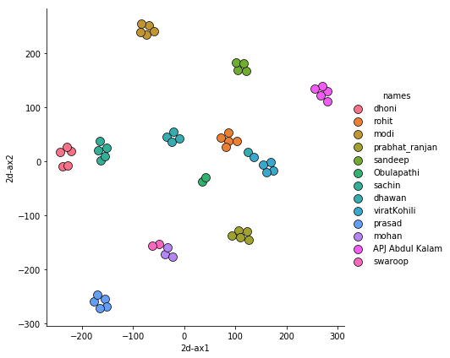
FaceNet Embeddings Visualization using T-SNE

Slide 28
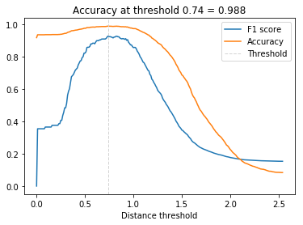
Distance (Best Threshold for the verification)

Slide 29
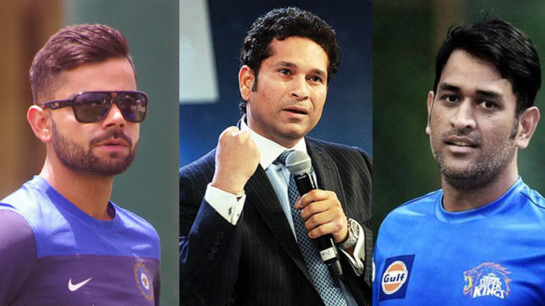
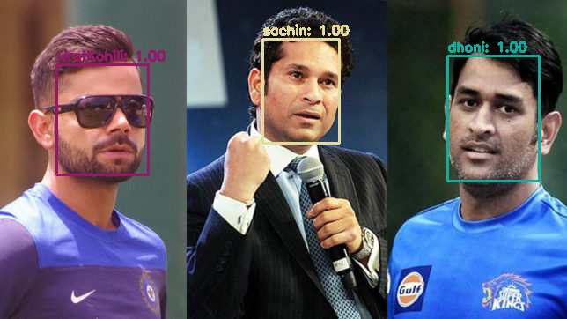
Results

Slide 30
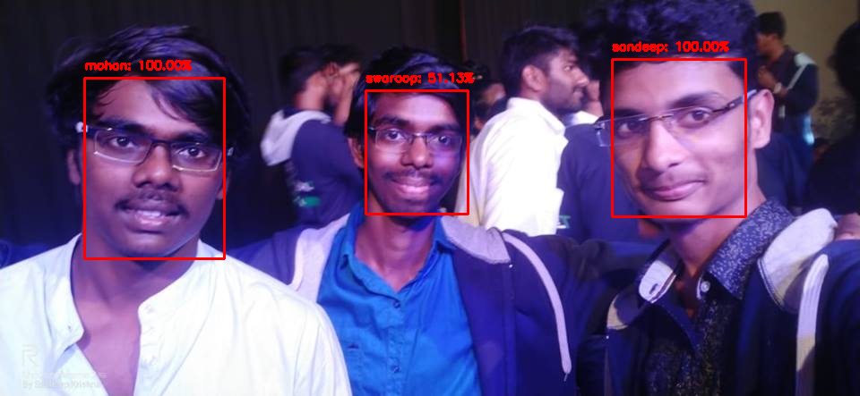
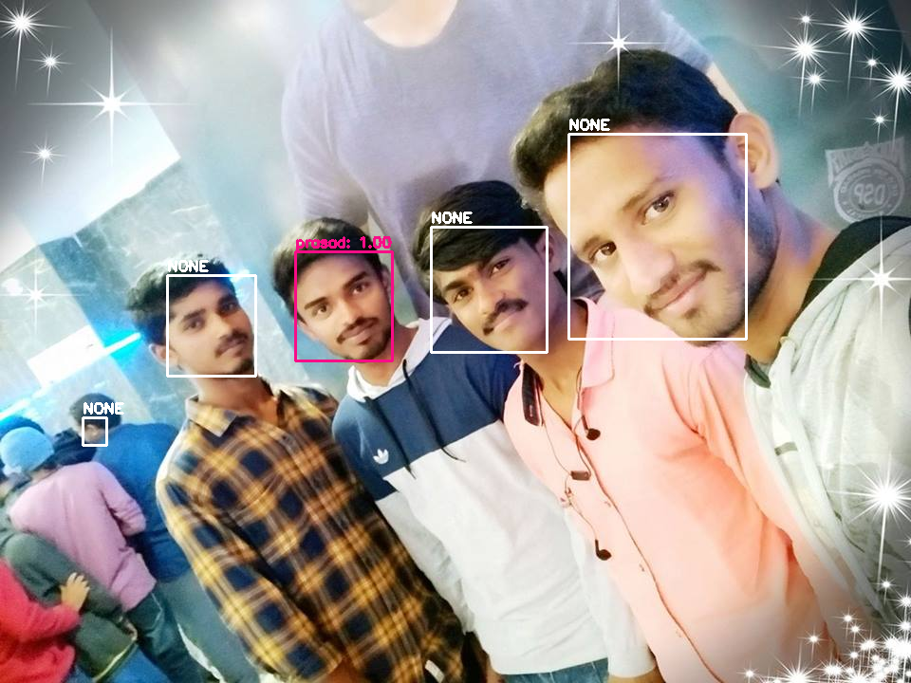
Result

Slide 31
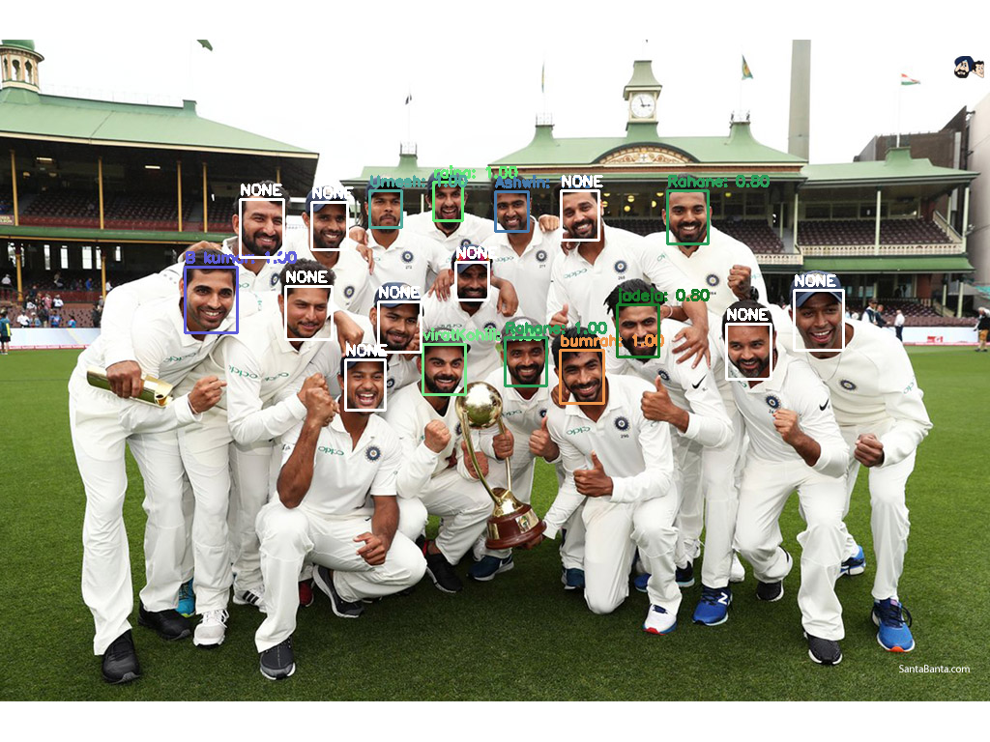

Slide 32
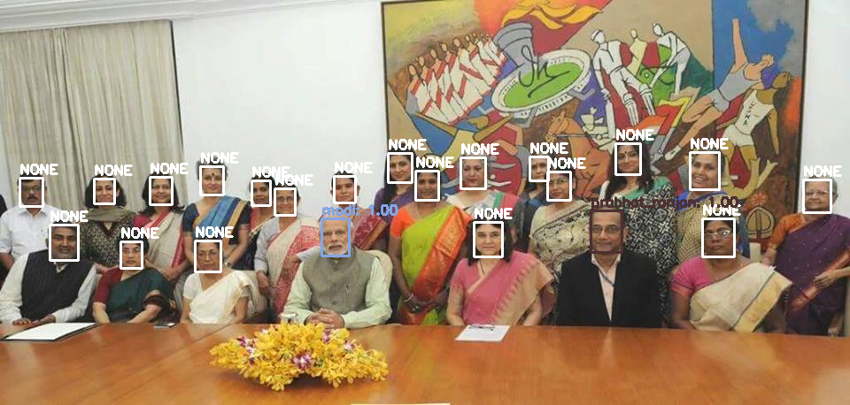

Slide 33
Pros
U.S. government at airports
Mobile phone makers in products
Colleges in classroom
Social media companies on websites
Businesses at entrances and restricted areas
Religious groups at places of worship
Retailers in stores

Slide 34
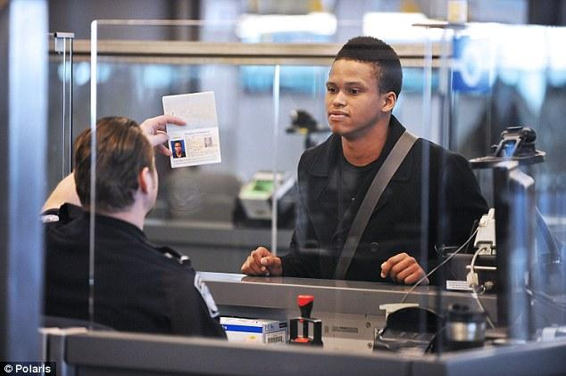
Airports : Problem

Slide 35
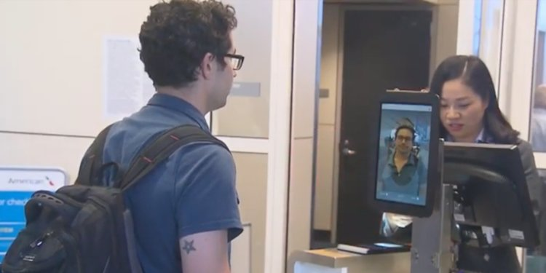
Airports : Solution

Slide 36
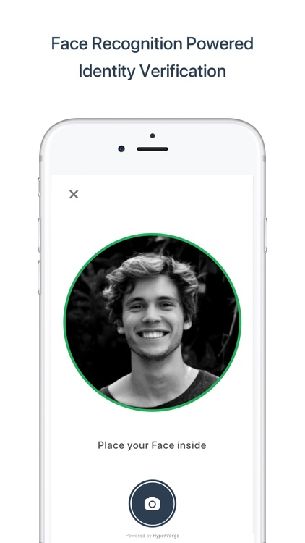
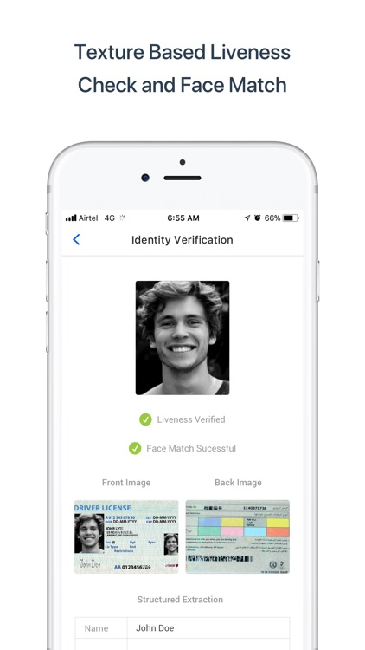
Identity Verification

Slide 37
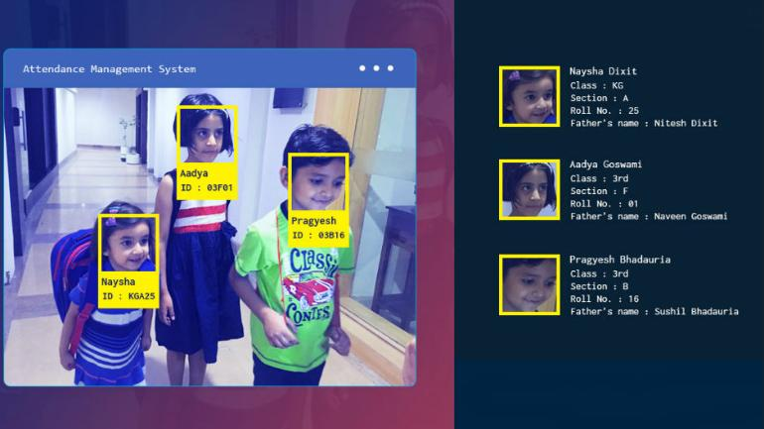
Attendance

Slide 38


